Slide 1
ENSE 271 - Activity 1
Team: Coruscantiens
Feras Daghmoush (3rd year SSE)
Ria chevli (3rd year SSE)
Zhuo Chen (4th year SSE)

Slide 2
New Design includes:
Two way communication
Elegant (clutterless)
Layout
Improved functionality
Career/Events/Job posting
Easy navigation

Slide 3
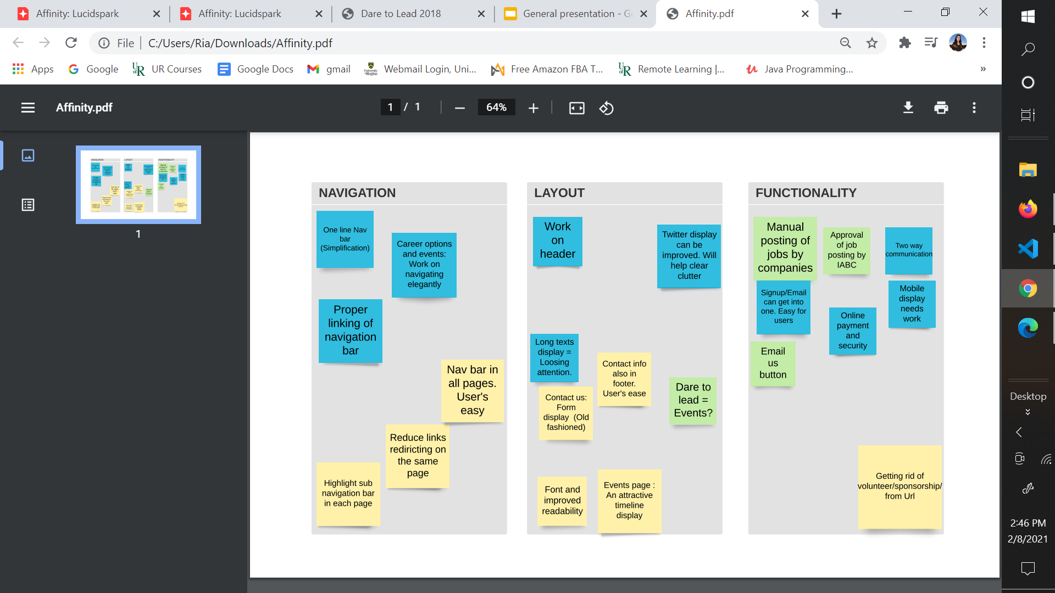
Affinity Diagram(s)
Organize facts, opinions, issues.
Identifying common problems
Top priority
Secondary Ideas
Questions for IABC

Slide 4
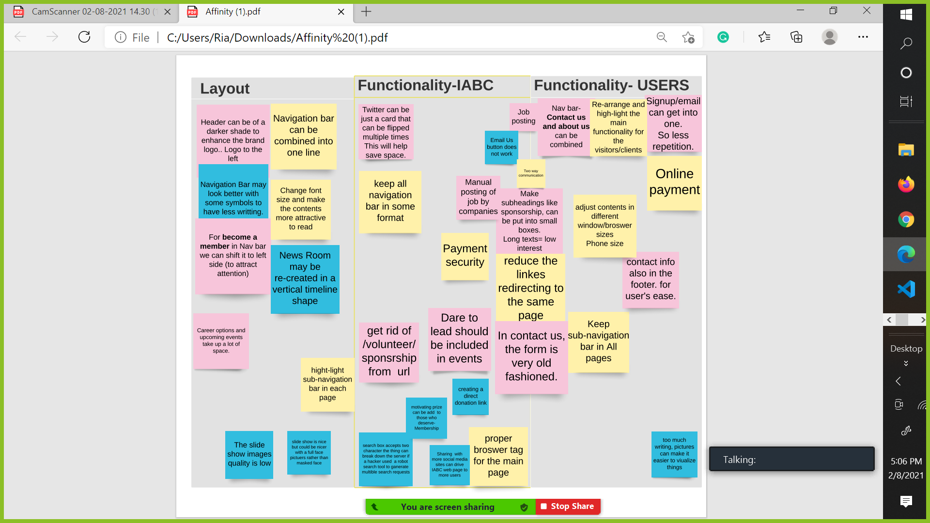
Affinity Diagram: (Technical view)

Slide 5
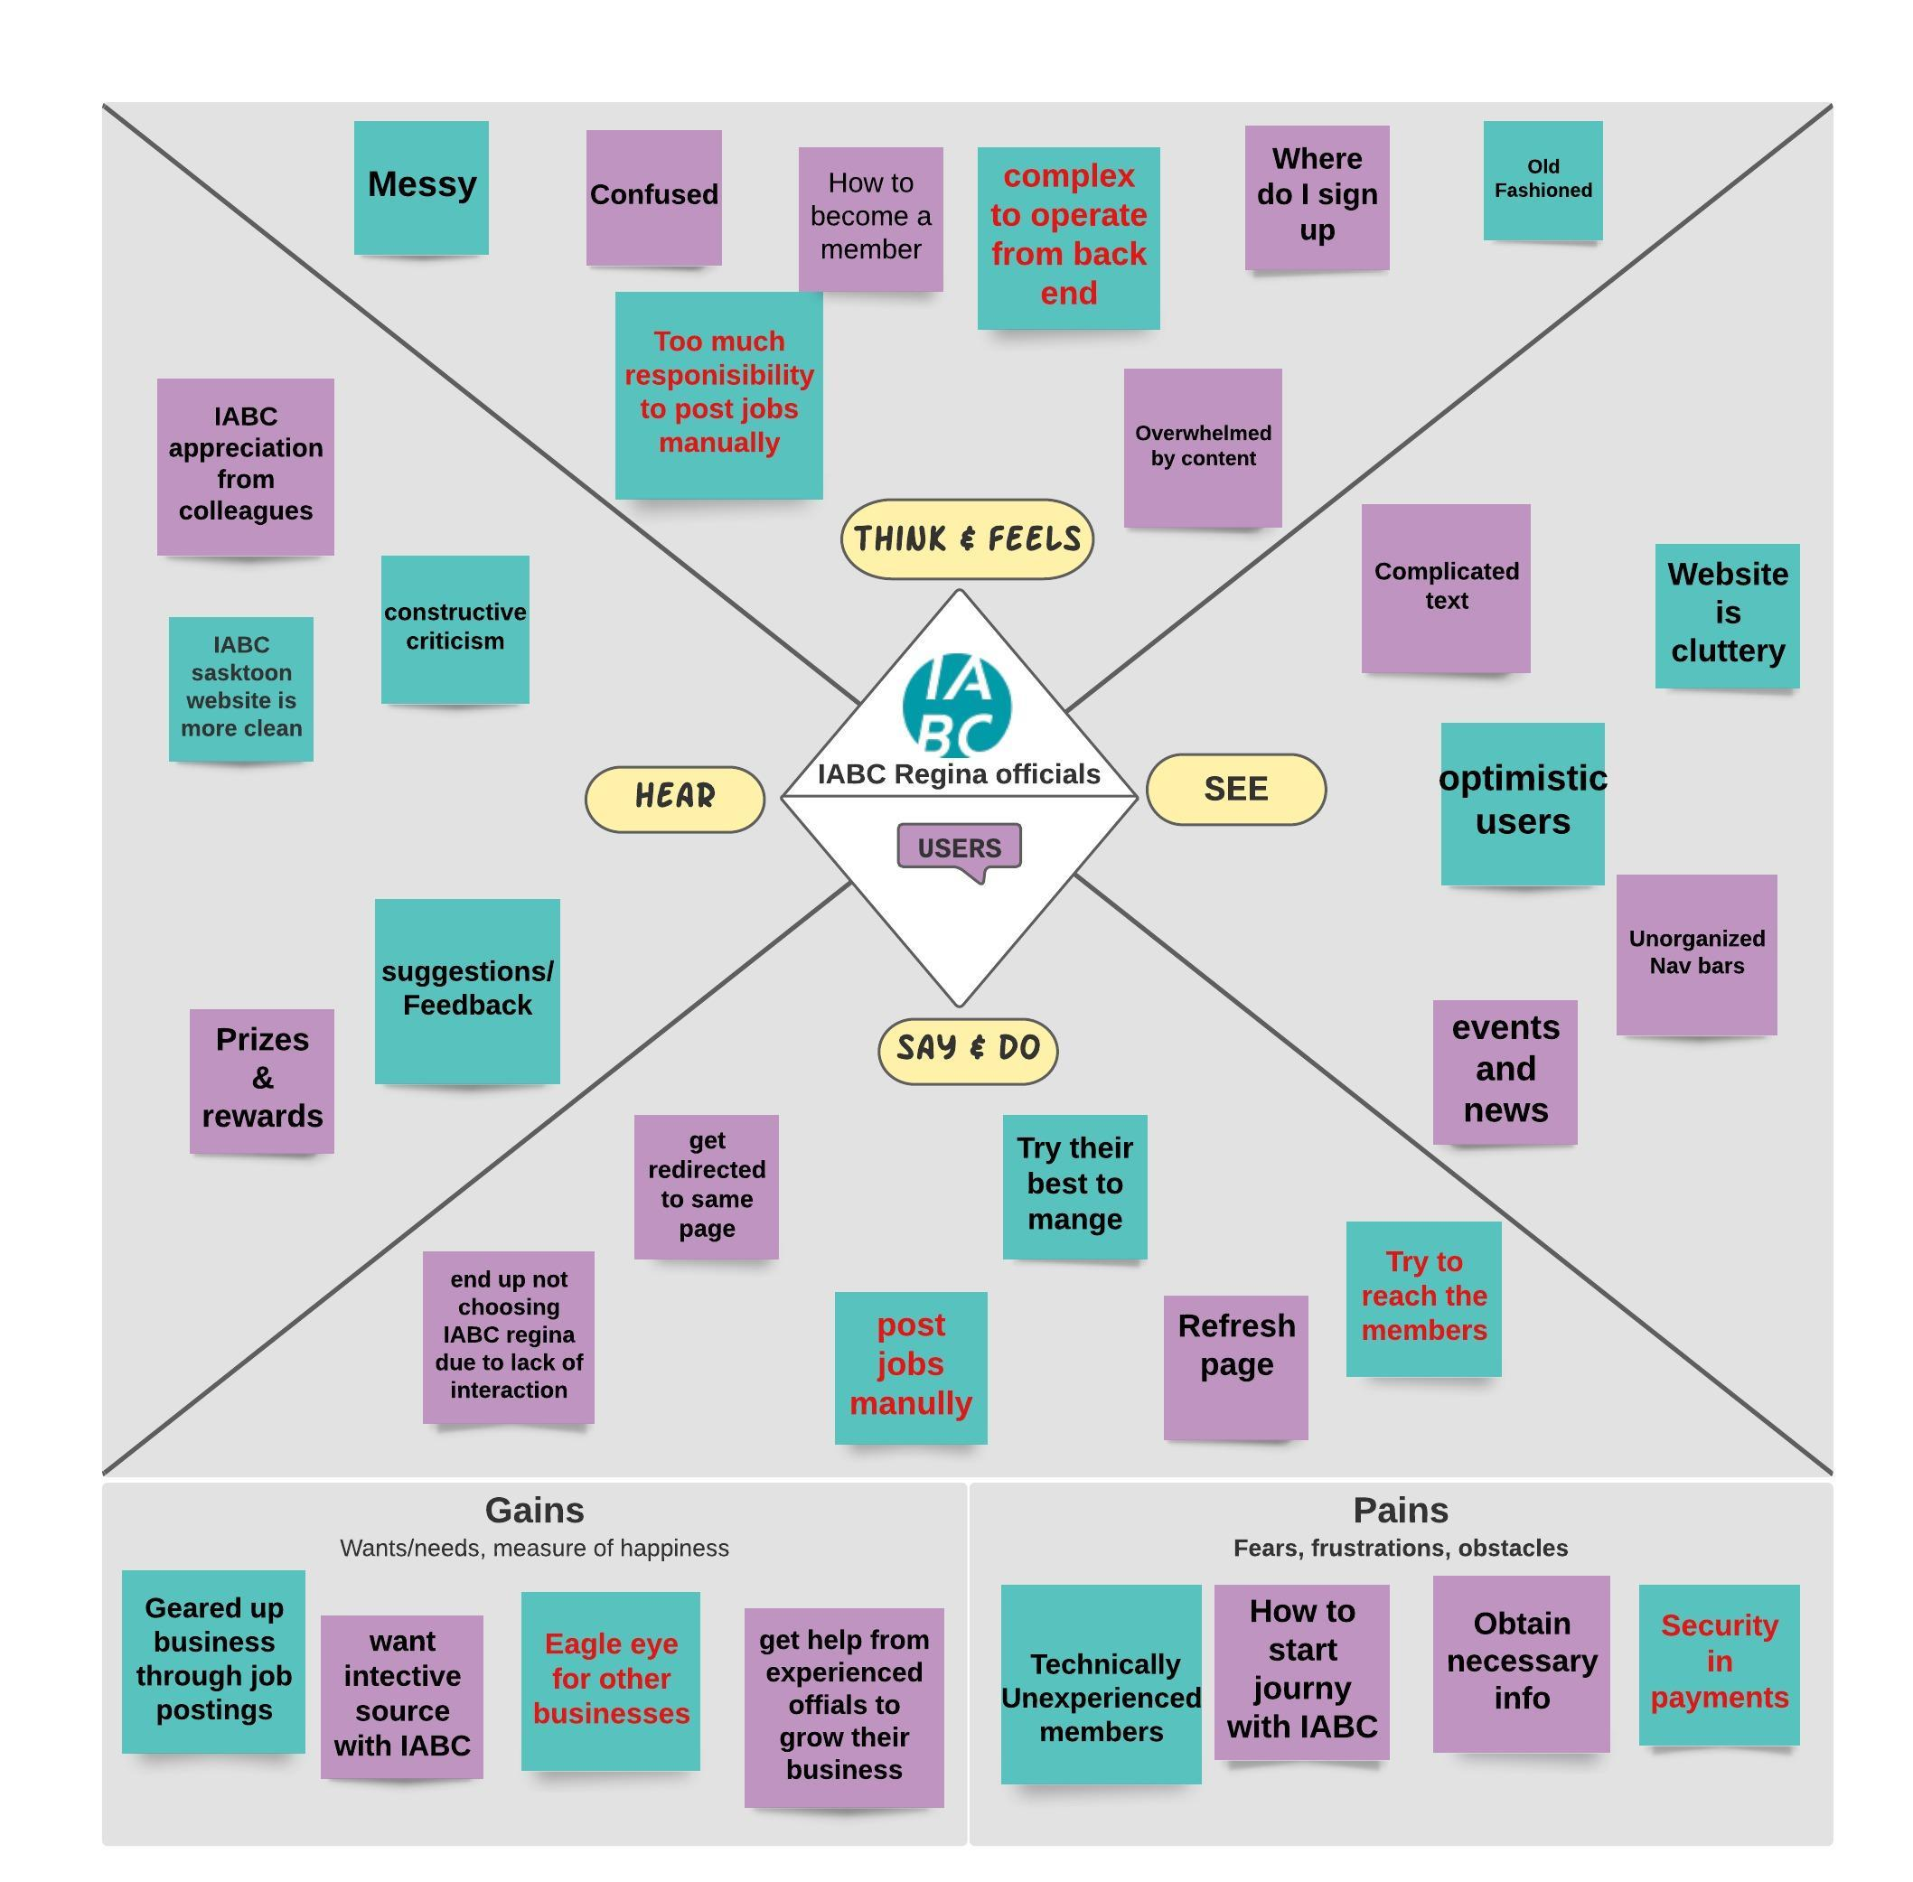
Empathy Mapping
Develop rich insight
Identify genuine issues
Concerns from user

Slide 6
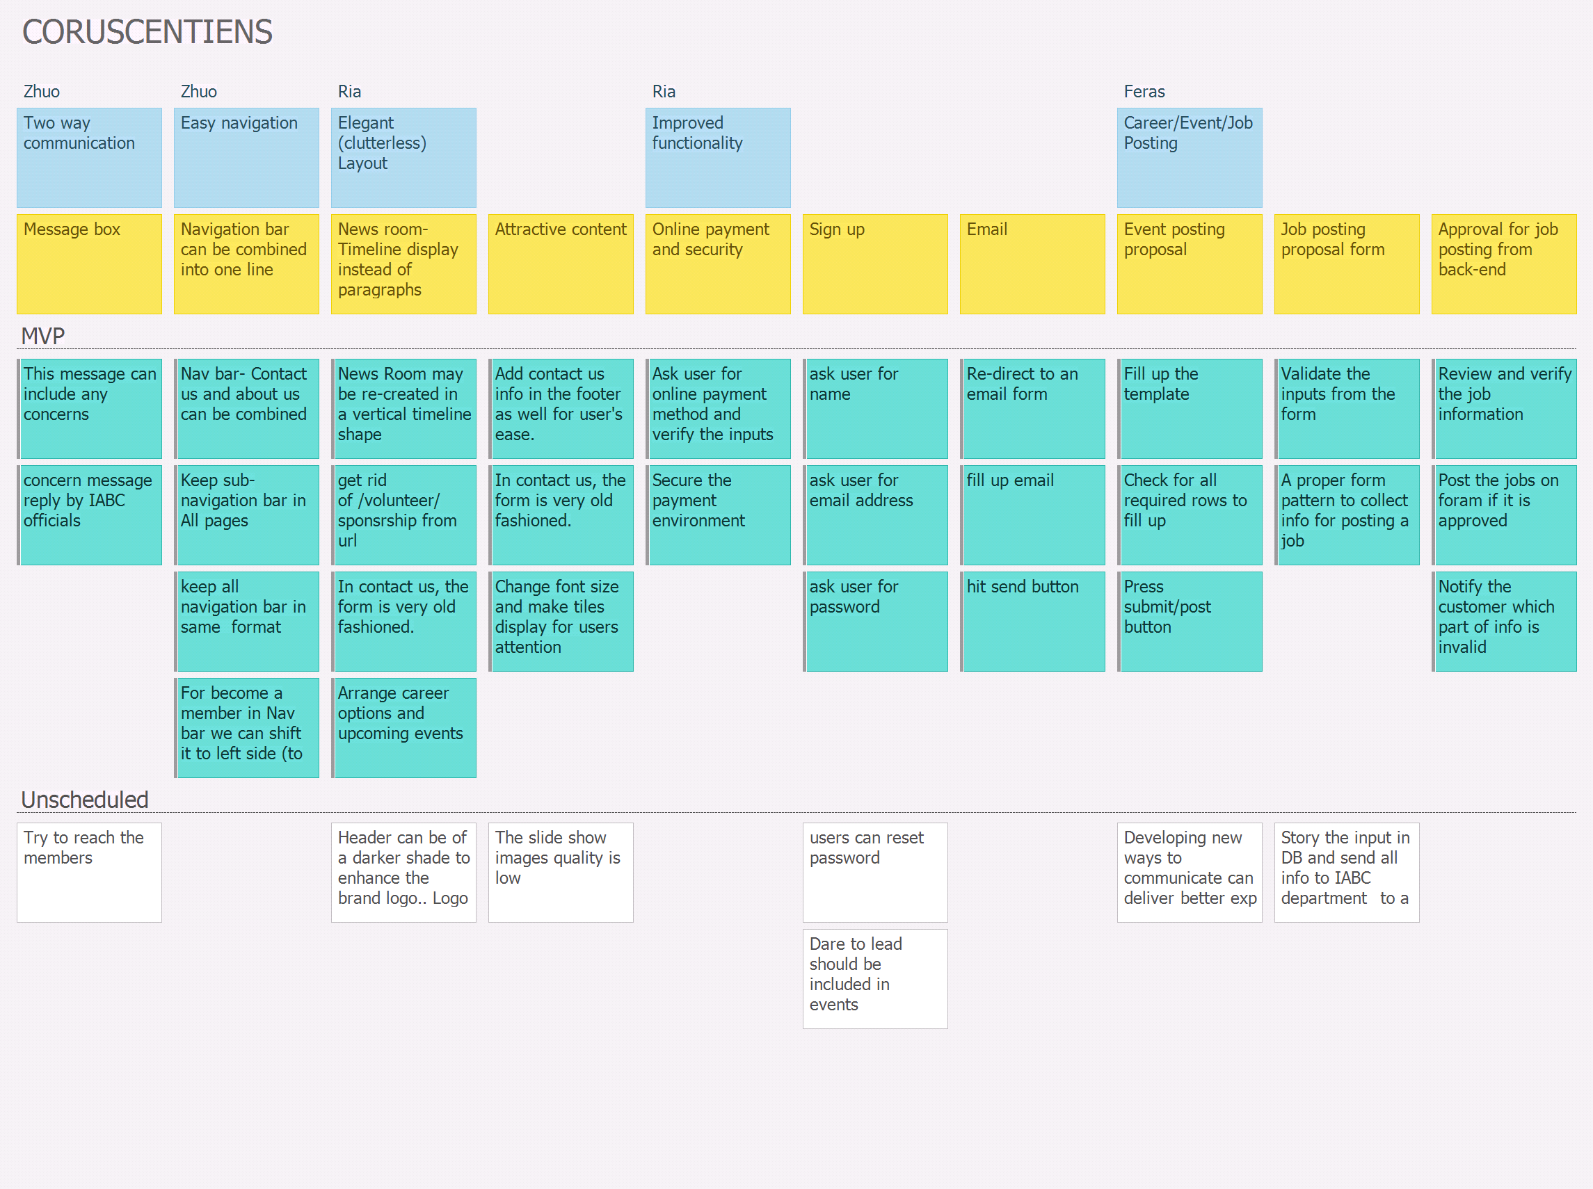
Story-Boarding
Backbone
Walking skeleton
Tasks

Slide 7
General Feedback.
Thank you for your time

